Slide 1
How to Connect your
current account with

Slide 2
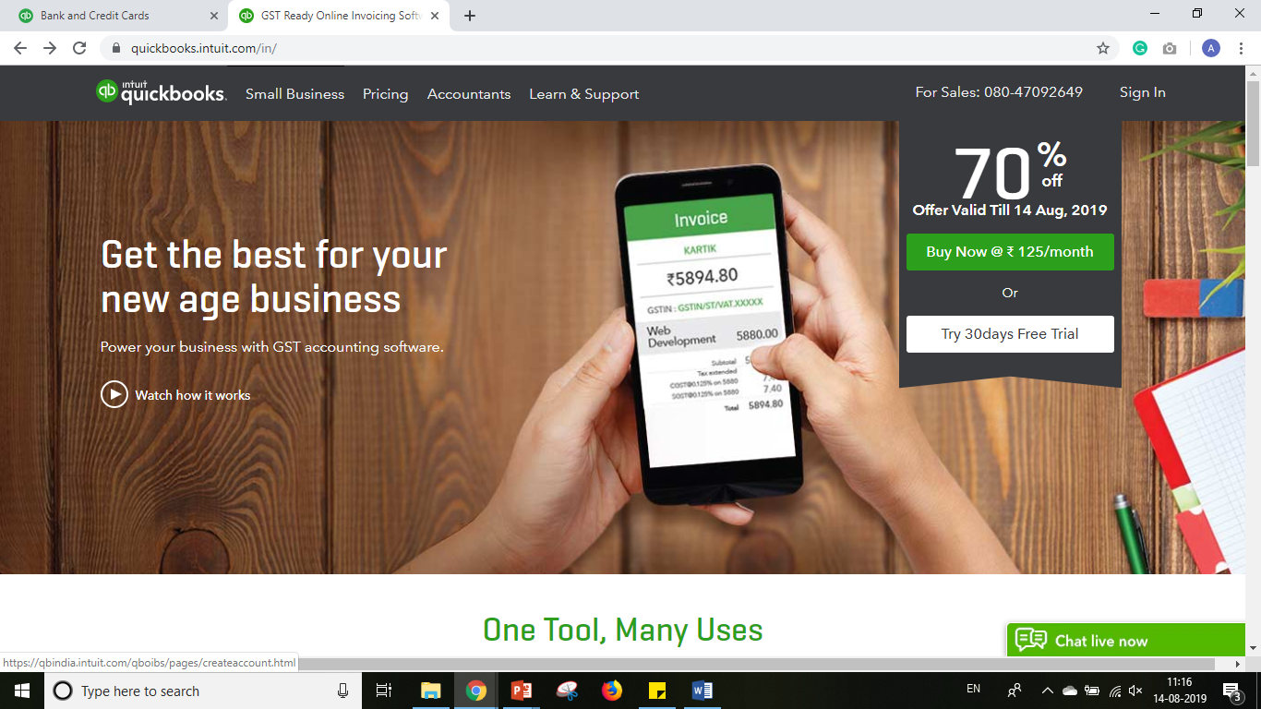
Sign into your QuickBooks Account

Slide 3
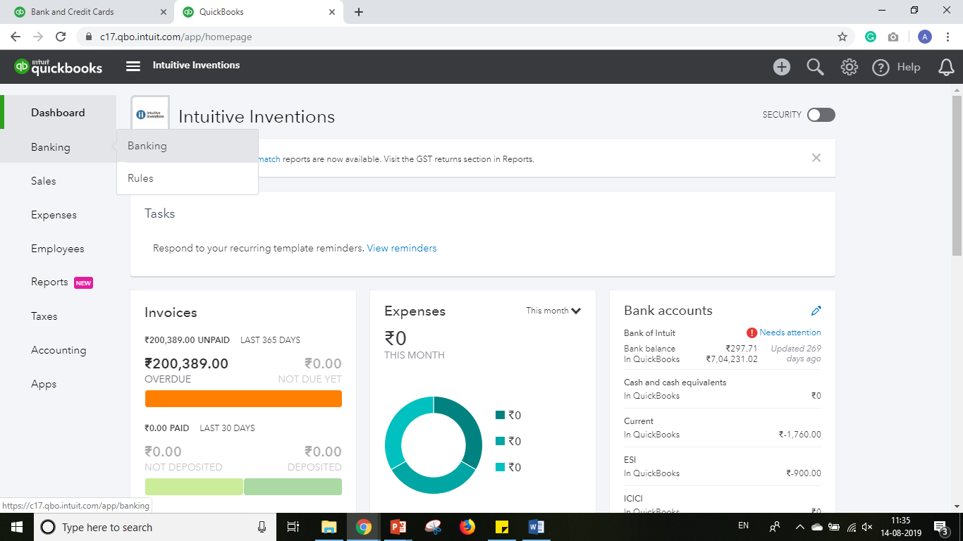
From the Dashboard / Home Page, Select ‘Banking’

Slide 4
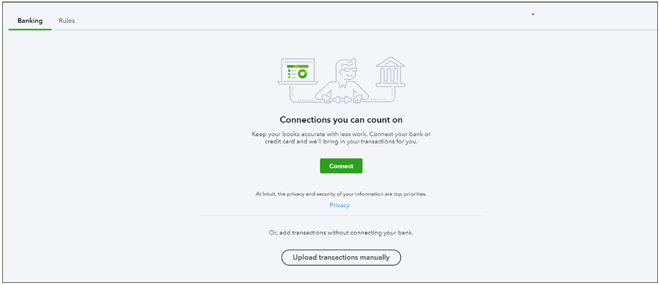
Click ‘Connect’

Slide 5
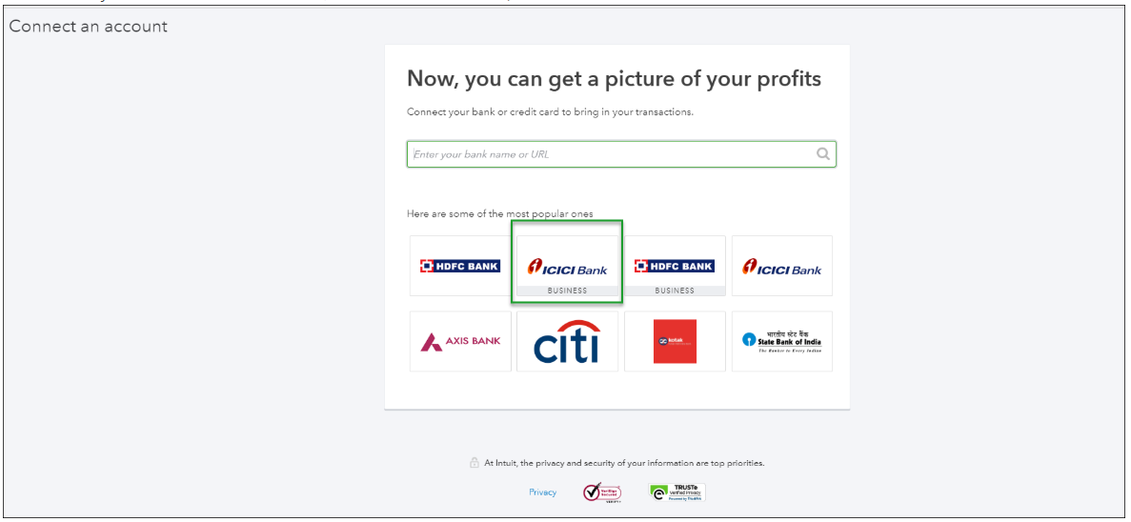
Search for ICICI Bank and select
ICICI Bank – Business Banking

Slide 6
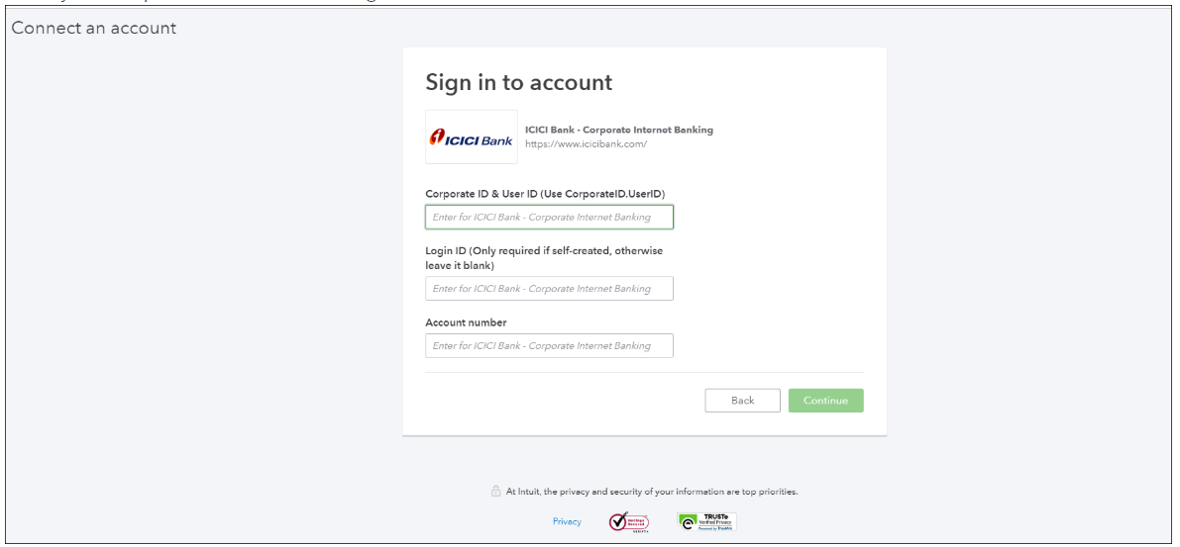
Enter your ICICI Bank Corporate ID & User ID, Login ID,
Current Account # and click ‘Continue’

Slide 7
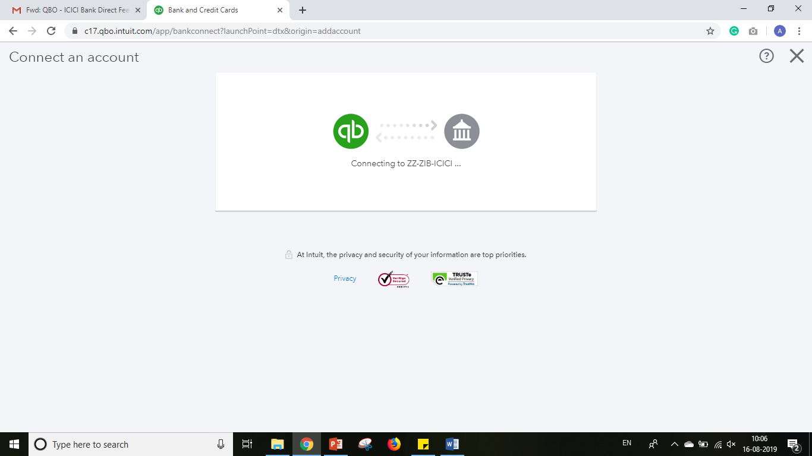
Complete the captcha and select continue. QuickBooks will send a connection request to ICICI Bank

Slide 8
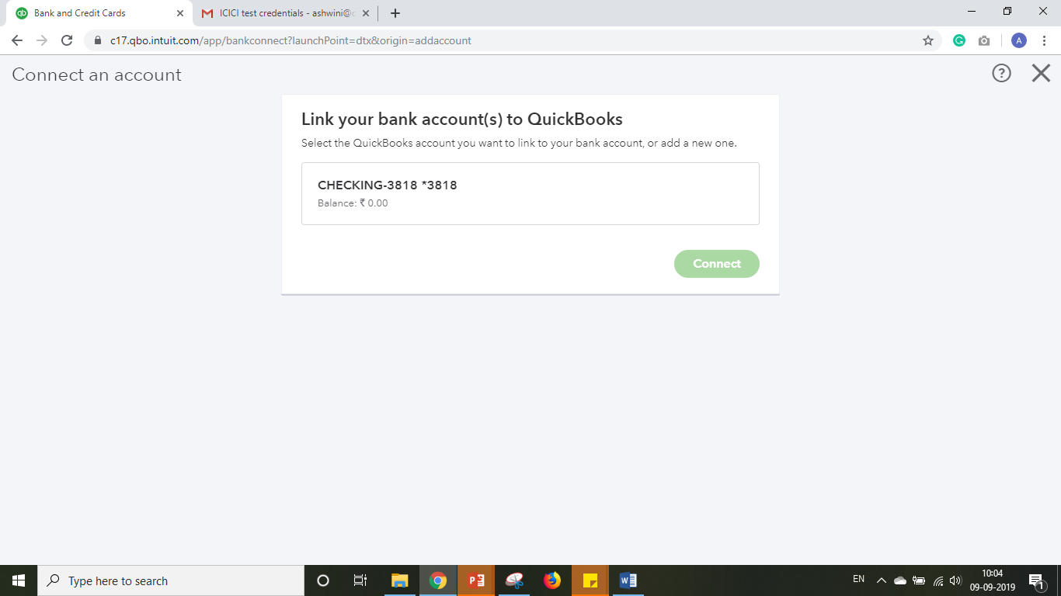
Click on the Rectangular Box. A dropdown list will appear listing all the Bank Accounts in your chart of accounts

Slide 9
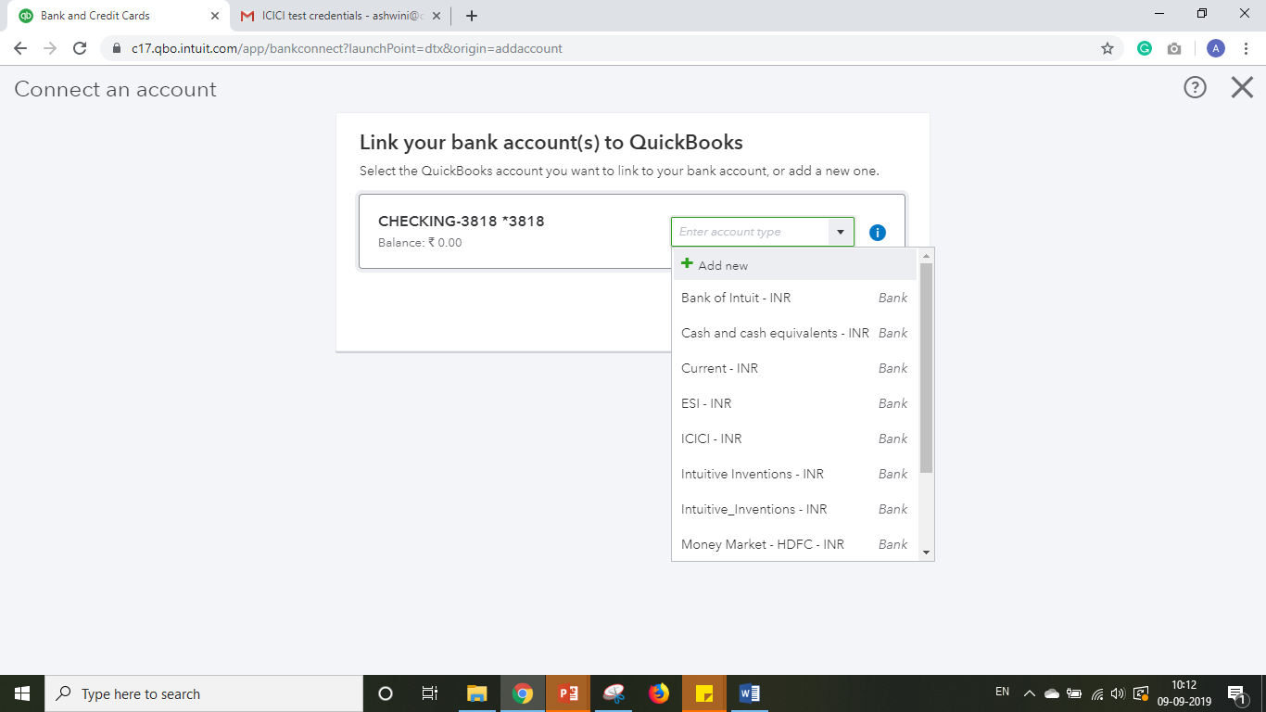
Select the appropriate account to be linked to your ICICI Bank Current Account

Slide 10
If none of the existing accounts map to your ICICI Bank Current Account, click ‘add new’ to add it to your chart of accounts

Slide 11
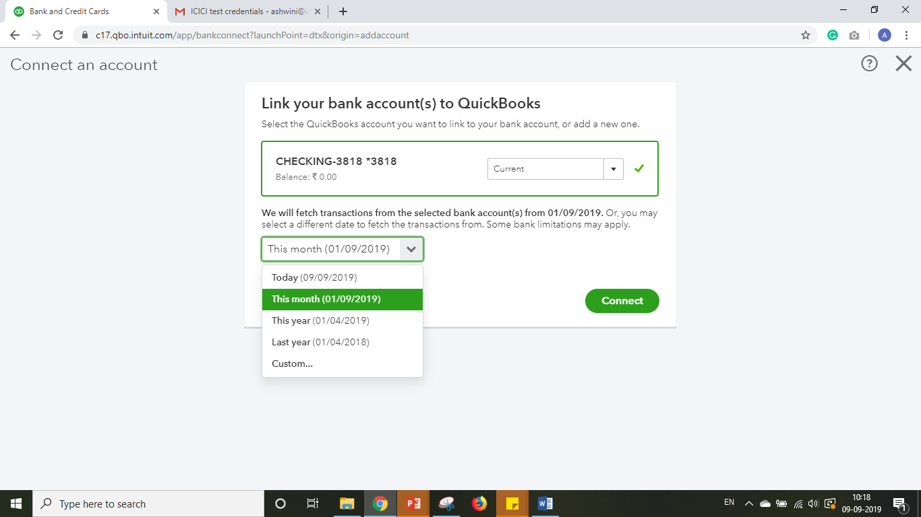
Select the date range for which transactions have to be fetched from the dropdown list (maximum of 90 days)

Slide 12
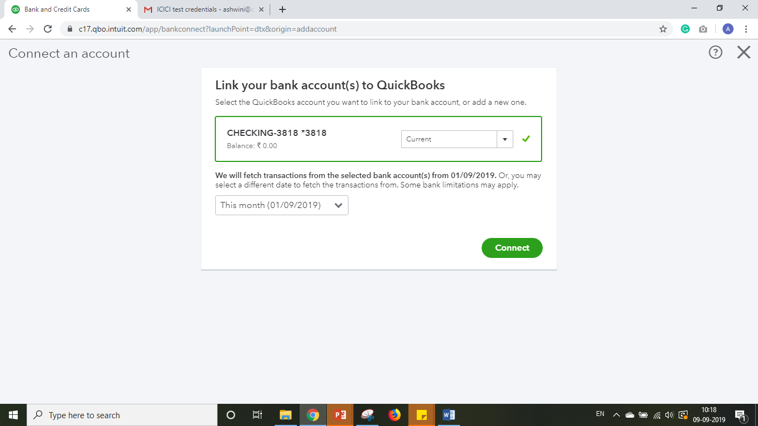
Click ‘Connect’

Slide 13
Visit ‘ICICI Bank – Corporate Internet Banking’ website to approve the request

Slide 14
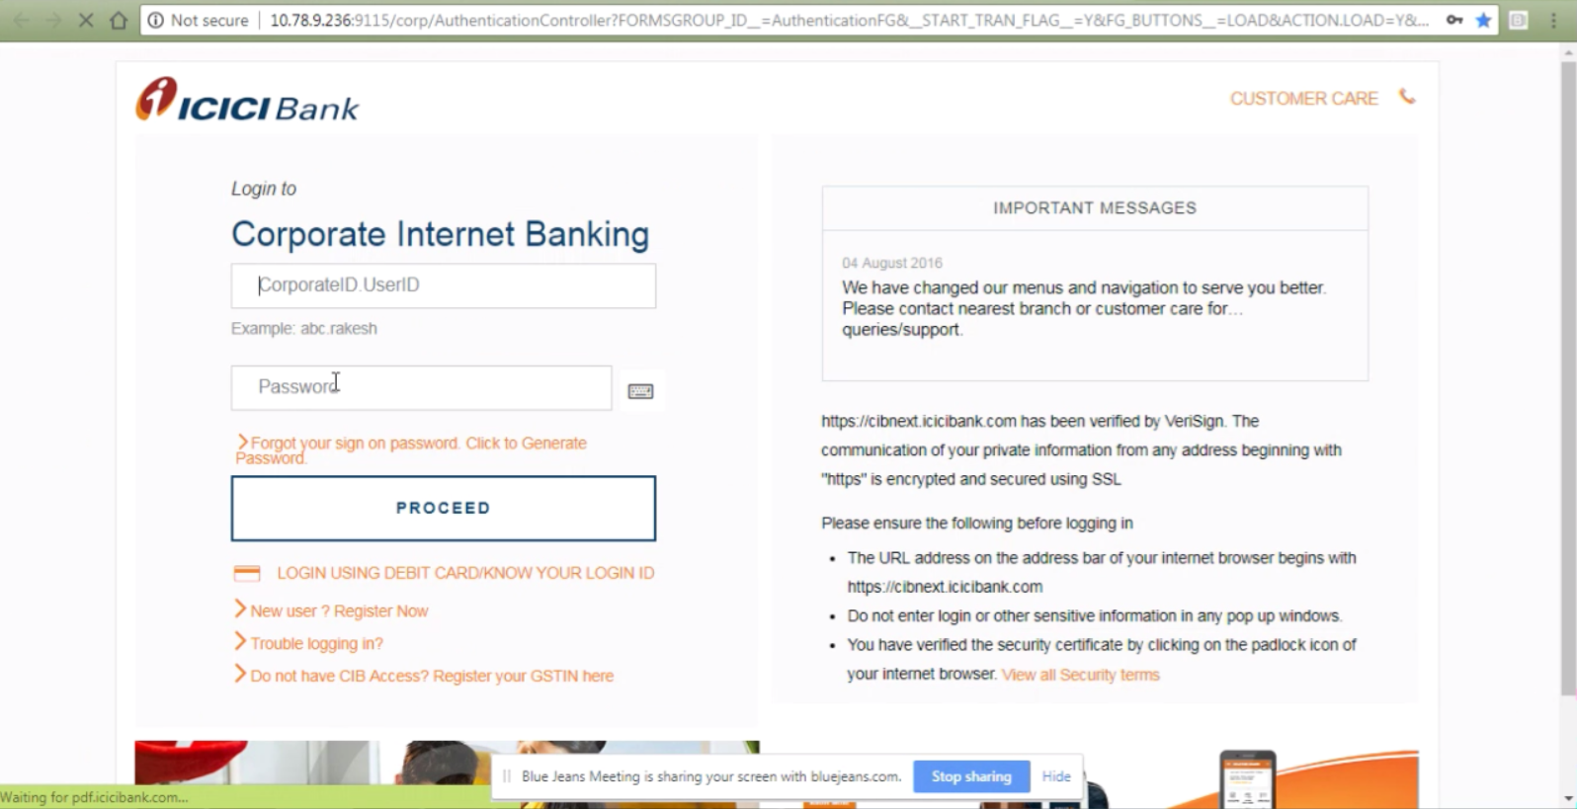
Login to ICICI Bank – Corporate Internet Banking

Slide 15
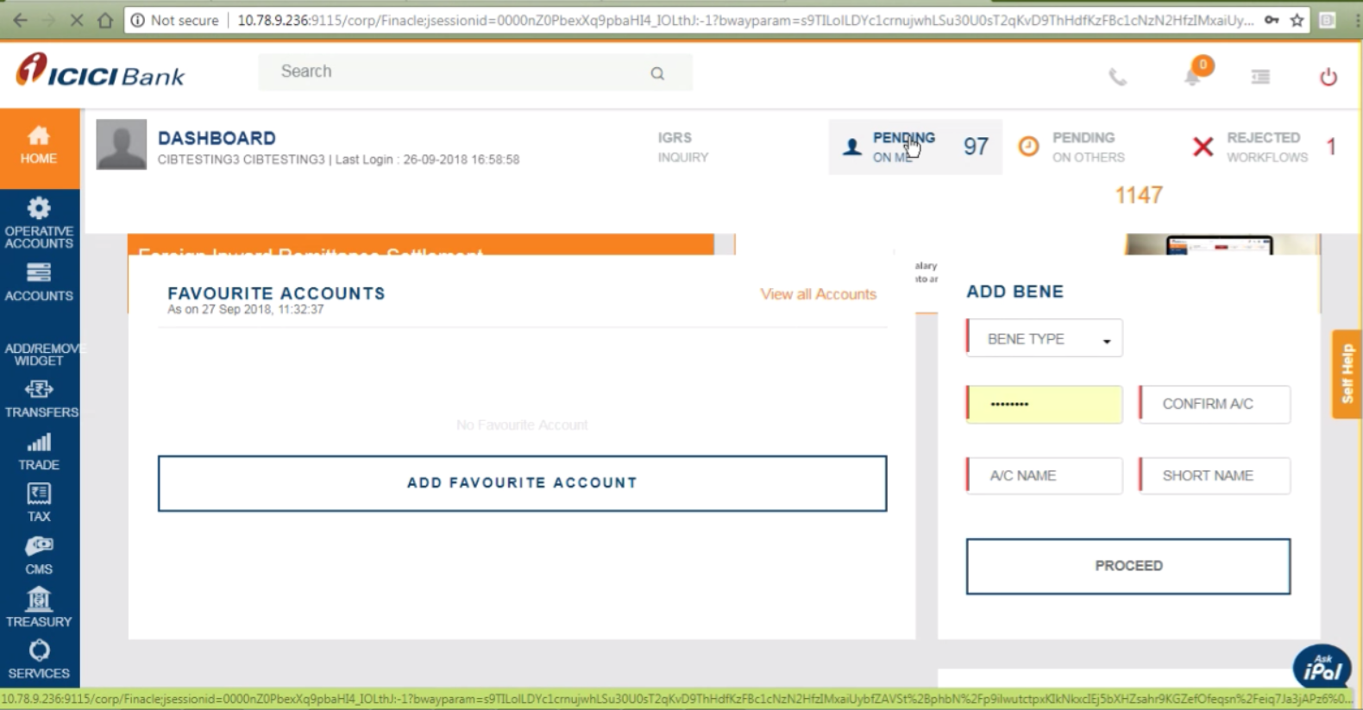
Select ‘Pending on Me’ tab from the Dashboard

Slide 16
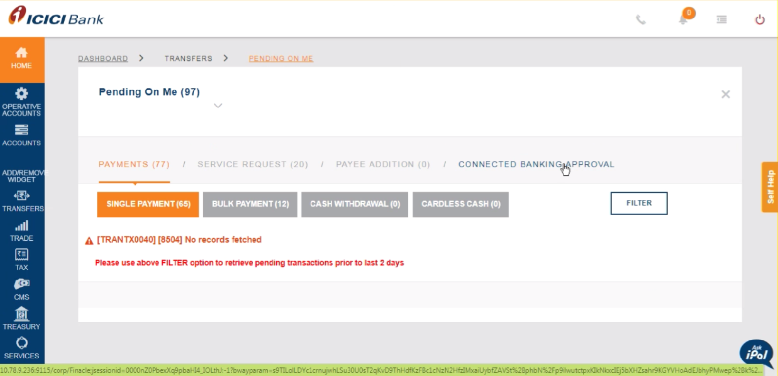
Click ‘Connected Banking Approval’ tab

Slide 17
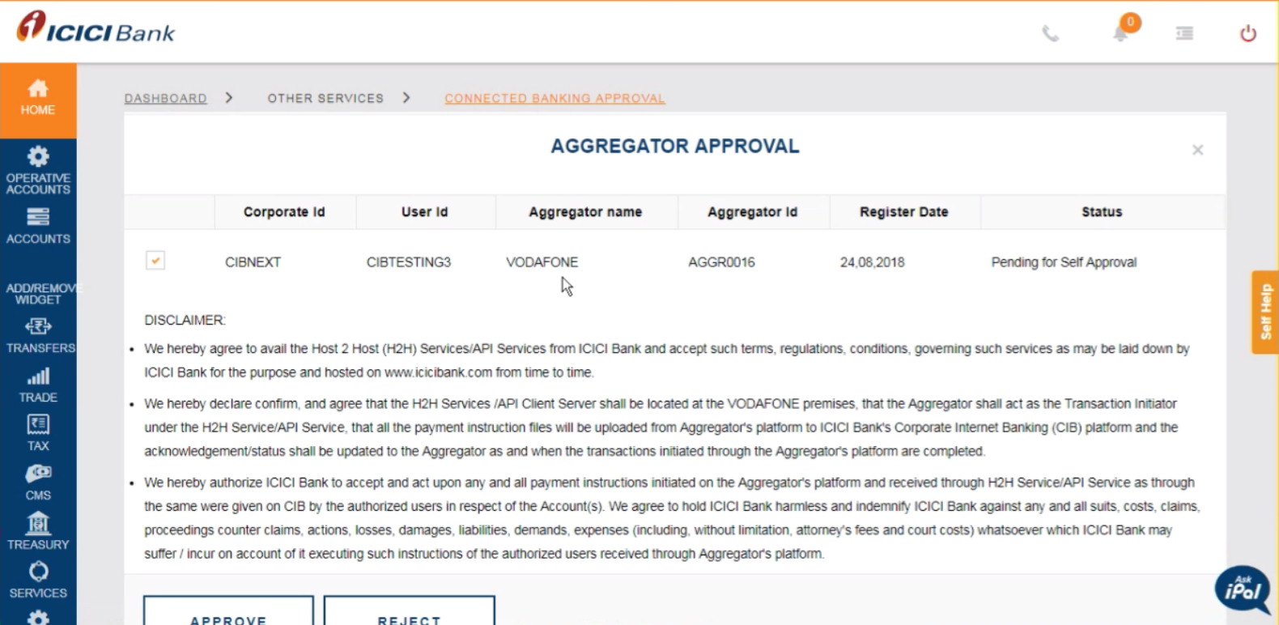
A list of pending aggregator approval requests is displayed. Select Intuit and click ‘Approve’
Intuit
AGGR0031

Slide 18
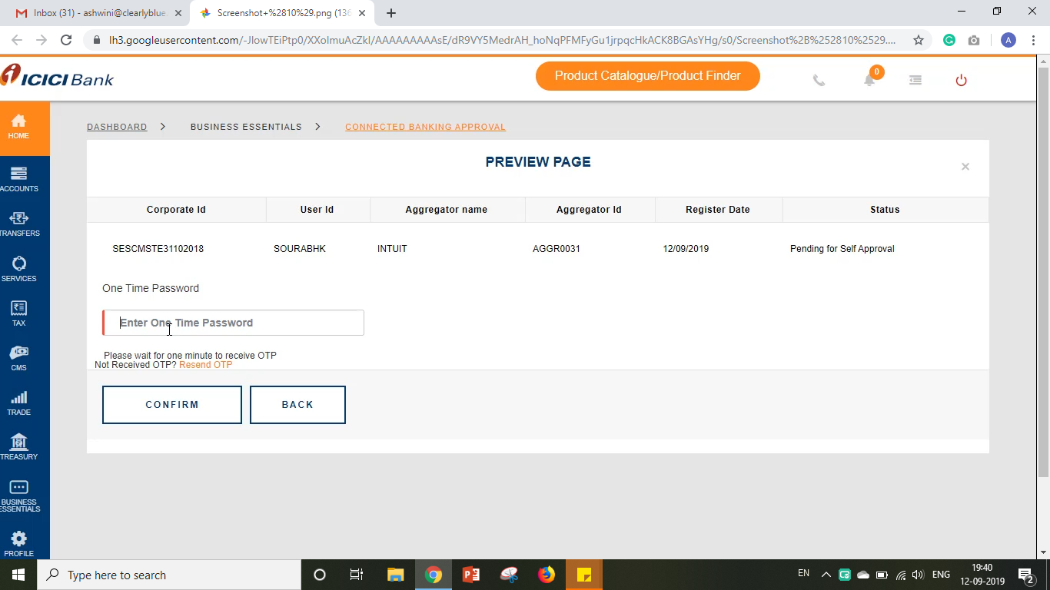
Preview the selected request and enter the one-time password. Click ‘Confirm’

Slide 19
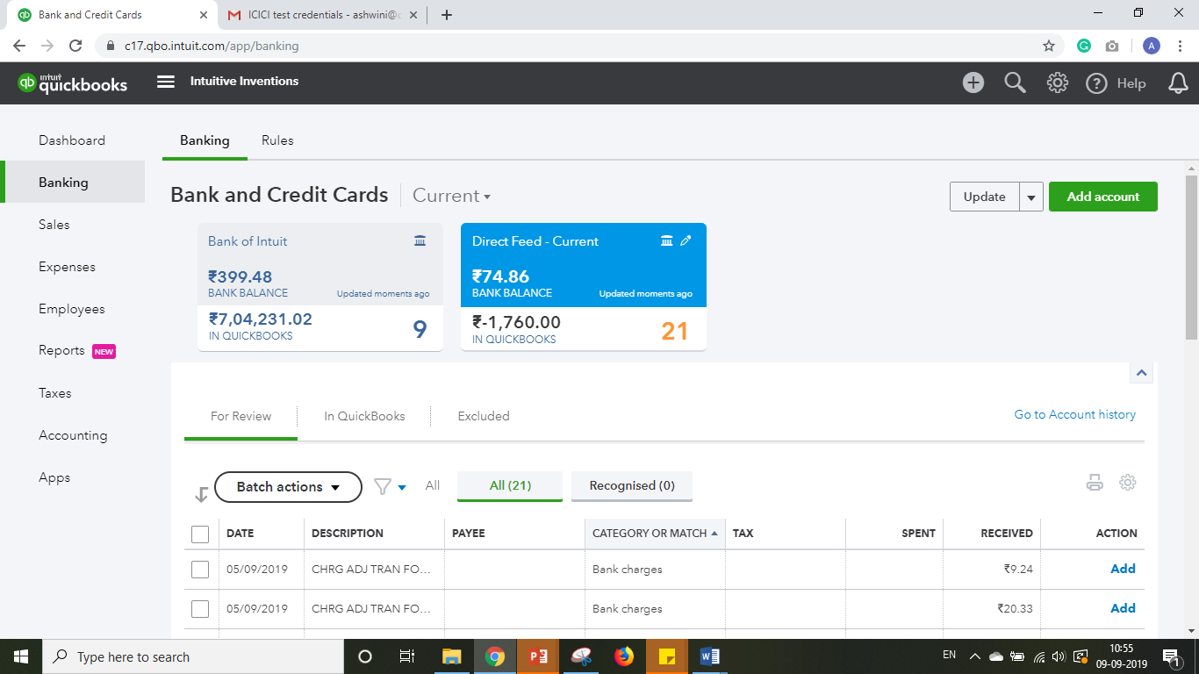
Go back to QuickBooks. On the top right of the Banking Page, click ‘Update’ to fetch account balance and transactions.

Slide 20
New Age Accounting Software for Modern Businesses
Complete
Data Security
Complete
Data Safety
Complete
Data Privacy

