Slide 1
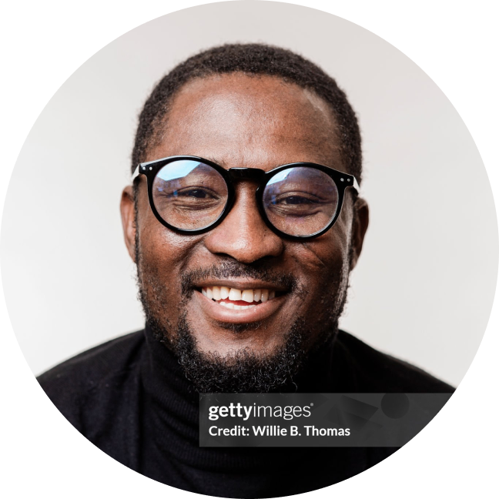
[CUSTOMIZE THIS SLIDE]
An offer to volunteer
in your classroom
I’m a local practitioner in Client Advisory Services (CAS), one of the fastest-growing areas of the accounting profession. I’d like to volunteer my time with your students.
[Firstname Lastname]
[Credential]
[Title], [Firm Name] · [City, State]

Slide 2

c
What is Client Advisory Services?
[CUSTOMIZE THIS SLIDE]
PRACTICE SNAPSHOT: [FIRM NAME]
In CAS, my firm provides strategic financial guidance to clients in [industry/industries] — handling bookkeeping, payroll, bill pay, and reporting, and guiding the owner on budgeting, forecasting, and big decisions.
YEARS IN PRACTICE
## years
TEAM SIZE
Financial operations
Reporting and insight
Strategic guidance
## members
[Customize: “My firm handles bookkeeping, payroll, and monthly close for ~40 small businesses.”]
[Customize: “We deliver
monthly financials and walk owners through what the numbers mean.”]
[Customize: “For clients who need it, we act as an outsourced CFO — budgeting, forecasting, planning for growth.”]
CLIENT NICHE
Cloud-based practice built on QuickBooks Online

Slide 3

Why I focus on CAS — and why firms across the country are investing in it
Large firms are prioritizing it
Firms offering it are growing
85%
Businesses are asking for it
61%
of the Top 100 accounting firms grew their CAS practices last year.
90%
Median annual CAS revenue rose 61%
over two years, to more than $1.6M
per practice.
of business clients report interest in advisory or consulting services from
their accountant.
Source: Accounting Today, 2025 Top 100 Firms
Source: 2024 AICPA & CPA.com CAS Benchmark Survey
Source: ADP survey

Slide 4
What I notice when I interview recent graduates — and the opportunity I think they’re missing
[CUSTOMIZE THIS SLIDE: FOR 2-YEAR COLLEGES]
1
2
3
Strong bookkeeping focus, less exposure to advisory
Limited time with the tools
firms use daily
A career path students rarely
hear about
Graduates arrive well grounded in bookkeeping. Fewer have seen advisory work up close — interpreting a client's books or helping an owner make a business decision.
Much of the profession runs on cloud platforms like QuickBooks Online. Many students graduate without hands-on time in them.
CAS offers the variety, client relationships, and entrepreneurial paths students say they want. Most simply haven't encountered it.

Slide 5
What I notice when I interview recent graduates — and the opportunity I think they’re missing
[CUSTOMIZE THIS SLIDE: FOR 4-YEAR COLLEGES]
1
2
3
Strong in tax and audit, less exposure to advisory
Limited time with the tools
firms use daily
A career path students rarely
hear about
Graduates arrive well grounded in compliance. Fewer have seen advisory work up close — interpreting a client's books or helping an owner make a business decision.
Much of the profession runs on cloud platforms like QuickBooks Online. Many students graduate without hands-on time in them.
CAS offers the variety, client relationships, and entrepreneurial paths students say they want. Most simply haven't encountered it.

Slide 6




Topics I could speak on
[CUSTOMIZE THIS SLIDE]
The client work itself
A sector I serve
The technology behind it
A specialty from
the work
[Customize: e.g., “How I guide small business owners through real decisions — pricing, cash flow, when to hire.”]
[Customize: e.g., “Accounting for nonprofits — fund accounting, grant reporting, board communication.” Or: “Construction — job costing, estimates, progress billing.”]
[Customize: e.g., “How my firm uses QuickBooks Online, Excel, and AI in day-to-day client work.”]
[Customize: e.g., “Multi-state sales tax — how it actually comes up for growing businesses.”]

Slide 7
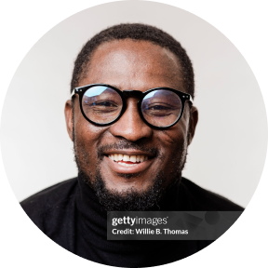
Why I’m doing this
[CUSTOMIZE THIS SLIDE]
[Fill in 2–3 sentences. Prompts: What drew you to this work? A professor, mentor, or first boss who opened a door for you? Your connection to this school or town? What you hope a student takes away from meeting a working practitioner.]

Slide 8
Why I’m doing this
[WORKED EXAMPLE: DELETE BEFORE SENDING]
A partner at my first firm took the time to show me what accounting could actually be — not just the work, but the career. I’ve built my practice twenty minutes from your campus, and I’d like to do the same for students here. If one of them leaves a session seeing a path they didn’t know existed, that's worth my afternoon.

Slide 9




Ways I could contribute
[CUSTOMIZE THIS SLIDE: DELETE WHAT DOESN'T APPLY)]
Guest lecture
Office hours
Mock interviews
Resume reviews
A 45-minute session on real CAS work: actual client scenarios, the judgment calls, how tools like QuickBooks fit in.
Short small-group Q&A with students about what the work is really like and paths into it.
Practice with a working employer before students face the actual job market.
Concrete feedback on presenting coursework and credentials to firms.
These are starting points. You know your students and your curriculum — I’m glad to fit whatever format is useful.

Slide 10

How this would work on your end
I am a
volunteer
I work within your curriculum
You set
the terms
There’s no fee and nothing behind it. I want to give back to the profession by helping students on their way into it.
Nothing about what you teach needs to change. A single class session or one office hour is a fine place to start.
Format, timing, and scope are yours to decide. And if it turns out not to be useful, I understand completely.

Slide 11


Free resources, if your program wants to go deeper
[OPTIONAL]
Separately from my own volunteering — Intuit for Education runs the Accounting Futures Program, a free program for higher-ed accounting departments. I don’t represent Intuit, but as a practitioner on QuickBooks, I can point you to it:
Free CAS curriculum for you
Free student certifications
Modular, classroom-ready courses built on real advisory workflows: interpreting financial reports, client communication, AI in accounting.
Industry-recognized QuickBooks credentials — the same ones firms like mine require of their own staff.
Learn more
intuit.com/solutions/education/accounting-futures

Slide 12



[CUSTOMIZE THIS SLIDE]
I’d love to connect —
15 minutes
[Firstname Lastname]
[email address]
Would you like to chat? I welcome the chance to hear about your program and see whether there's a fit for your students.
[phone number]
[LinkedIn]

